Slide 1
my.SDSU Change Ambassadors Meeting #16

Slide 2





my.SDSU Project Guiding Principles
Transform The Student Experience
Adopt the CSU Standard
Adopt Leading Practices & Business Processes
Transform the Use and Availability of Data
Foster Collaboration & Community Engagement
Enhance the student experience through more student-centric and transparent processes.
Adopt CSU technology Standards to provide a streamlined, cohesive front and back-end user experience that is aligned with CSU best practices.
Adopt leading practices and business processes that improve effectiveness, access and efficiency.
Increase access to data in support of decision-making that tells the story of SDSU for current and future students.
Facilitate inclusive communication & foster community involvement and trust for a people-centric implementation.
Notes:
Tony

Slide 3
Agenda
01
my.SDSU Change Ambassadors Jam Board
25 minutes
02
my.SDSU Updates
10 minutes
Notes:
Tony

Slide 4
Jam Board Feedback Activity

Slide 5
Key Deadlines, Updates & Access for my.SDSU
Key Deadlines & Updates for Fall 2022
Access to my.SDSU
Financial Aid & Student Financials
The disbursement process has begun - students will get their money the week of 8/15
Financial Aid will apply to a student’s tuition and fees
Students are required to pay their tuition and fees by 8/15
FOR FALL 2022 ONLY - this is a soft deadline
Note: Outreach will be done to students who have not paid by the end of the add/drop period
Who is currently in my.SDSU?
Students who are active in Fall 2022 (without a terminal hold, i.e. graduation)
Who is not currently in my.SDSU?
Faculty & Staff will get into my.SDSU closer to the October Go-Live (more info coming soon)
Continuing students with a hold on their record prior to Fall 2022
Note: If a student says they do not have access to my.SDSU, ask them if they have a hold in WebPortal and work with them to resolve the hold so they can get access to my.SDSU.

Slide 6
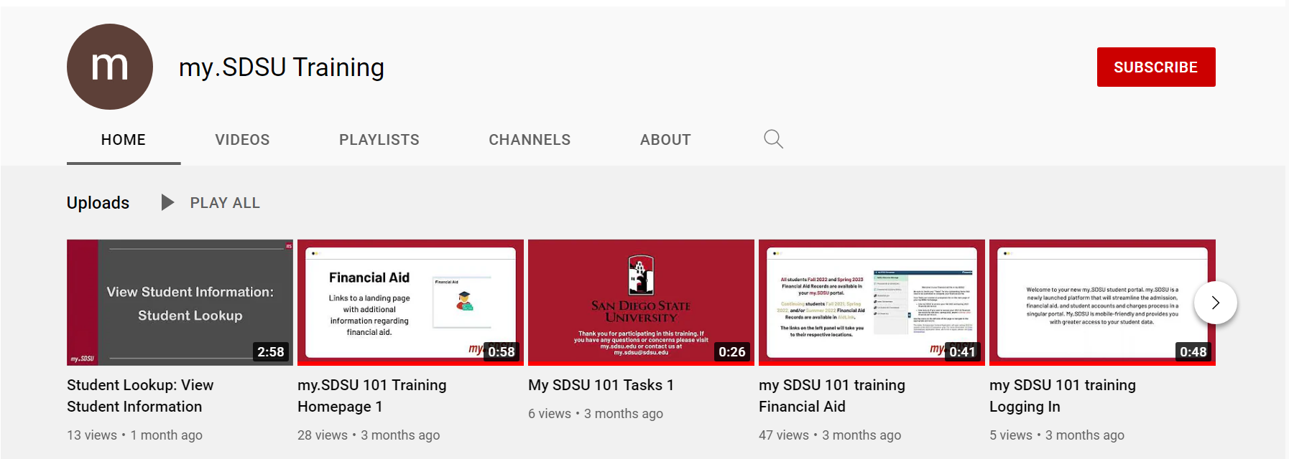
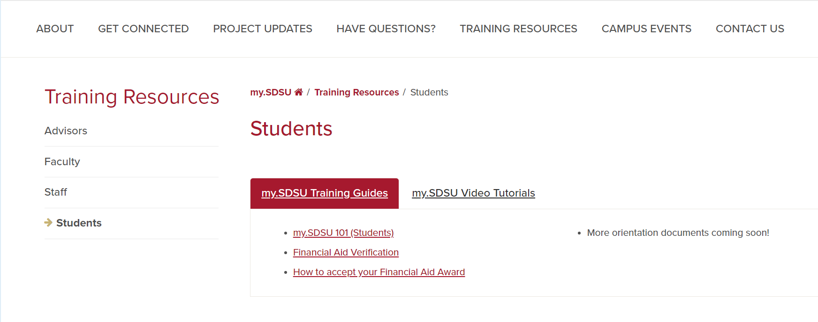
my.SDSU Training Resources
Link to my.SDSU Video Tutorials
Link to my.SDSU Training Guides
Notes:
Palak

Slide 7
THANK YOU
Email: my.sdsu@sdsu.edu
Website: my.sdsu.edu

