Slide 1


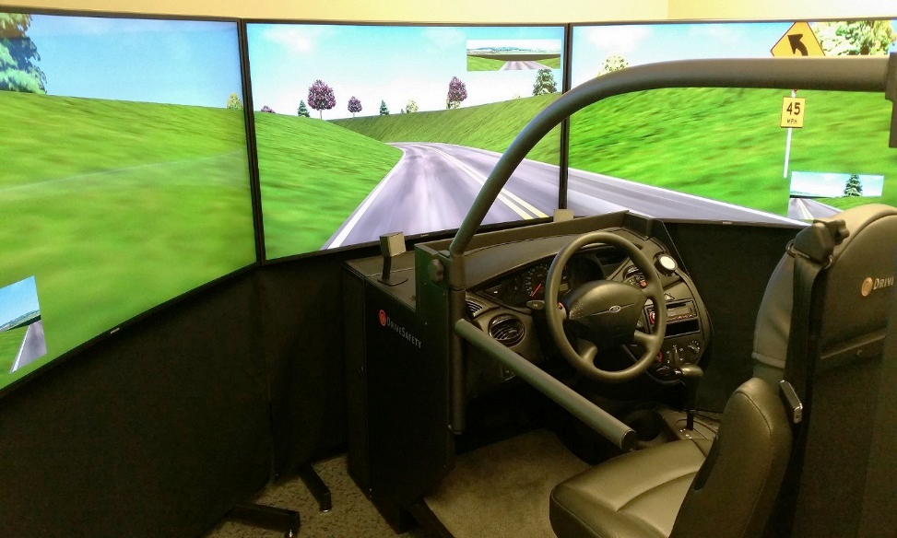
Driving Simulator Study
Purpose: Study effects of different curve warning systems on drivers’ behavior
Location: Engineering Building, San Diego State University
Duration: No more than Two hours
Eligibility: At least 18 years of age and possess a driving license
Participants will be compensated $30
What you will be asked to do:
After familiarization with the simulator environment, you will be asked to drive in different scenarios. In each scenario, a type of warning system guides you throughout the drive. At the end of each scenario you complete a questionnaire and provide feedback from your experience of using the system.
If you are interested, Please Contact me for more information at:
Alidad Ahmadi
(760) 798 5453
aahmadi@sdsu.edu
Principle Investigator:
Dr. Sahar Ghanipoor Machiani
Department of Civil, Construction, and Environmental Engineering
Email: sghanipoor@mail.sdsu.edu
Tel: (619) 594-1937

