Slide 1

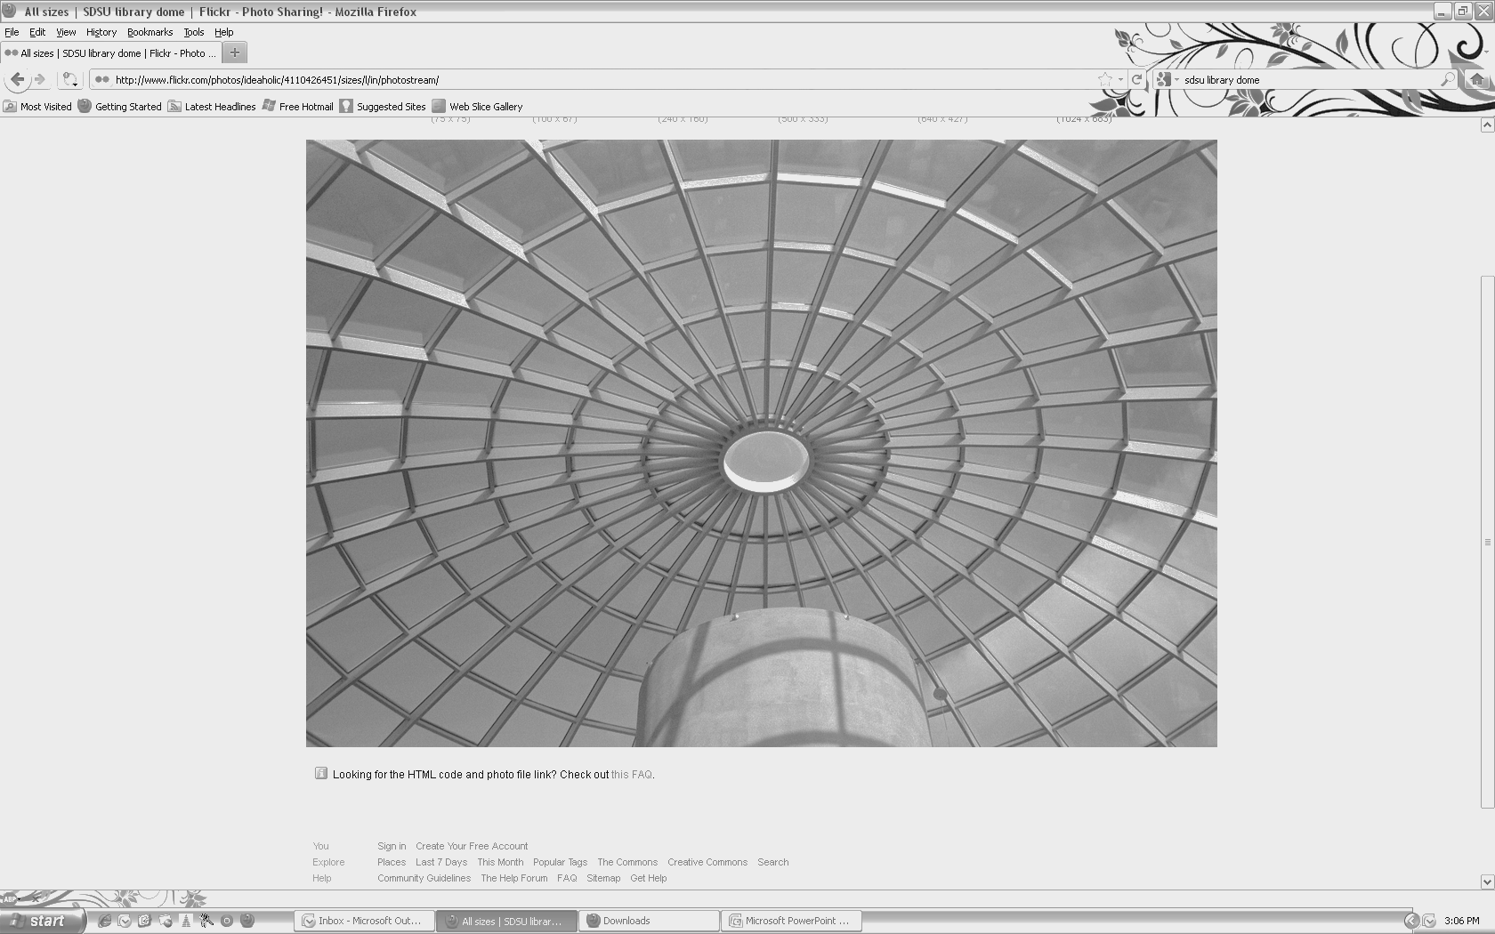
Department of Aerospace Engineering
SEMINAR
“Nonlinear Dynamics and Control of Mechanical, Aerospace, and Robotic Systems”
Mahmut Reyhanoglu, Ph.D.
Professor of Engineering Physics
Embry-Riddle Aeronautical University
Daytona Beach, Florida
Tuesday, March 17, 2015 – 10:30am
College of Engineering, Room E-203
This talk summarizes my research activities over the past several years. The talk is organized into two parts. The first part gives an overview of important research results on the dynamics and control of nonholonomic dynamic systems, i.e., dynamic systems satisfying nonintegrable kinematics relations, as well as underactuated mechanical systems satisfying nonintegrable acceleration relations. Control design methods for such systems include the use of sigma processes and geometric phases. The results are applied to mechanical systems with nonholonomic constraints, such as wheeled mobile robots, and to aerospace and mechanical systems with nonholonomic motion invariants including internally actuated space robots (analog to falling cats). The results are also applied to underactuated space and marine vehicles and underactuated robot manipulators. Finally, the second part of the talk briefly mentions the most recent research activities that include nonlinear control of unmanned aerial vehicles (UAVs), thermoacoustic oscillations, and higher-order nonholonomic systems, such as robotic systems that are subject to jerk and snap constraints. The effectiveness of these research results is demonstrated through computer simulations and animated movies of controlled motions of the above-mentioned physical examples.
Speaker Bio: Mahmut Reyhanoglu received the Ph.D. degree in Aerospace Engineering from the University of Michigan, Ann Arbor, Michigan, in 1992. He is presently a Professor of Engineering Physics at Embry-Riddle Aeronautical University, Daytona Beach, Florida, USA. His major research interests are in the areas of nonlinear dynamics, controls, and robotics, with particular emphasis on application to mechanical and aerospace systems. Dr. Reyhanoglu has authored/co-authored several book chapters and over 100 peer-reviewed journal/proceedings papers. He served on the IEEE Transactions on Automatic Control Editorial Board and on the IEEE Control Systems Society Conference Editorial Board as an Associate Editor. He also served as International Program Committee member for several conferences and as a member of AIAA Guidance, Navigation, and Control Technical Committee. Dr. Reyhanoglu is a Senior Member of IEEE and AIAA. Currently, he is an Associate Editor of International Journal of Aerospace Engineering.
.
San Diego State University
Department of Aerospace Engineering ▪ 5500 Campanile Drive ▪ San Diego ▪ CA ▪ 92182-1323
Phone: 619-594-6074
http://aerospace.sdsu.edu/aerospaceengineering/

