Slide 1

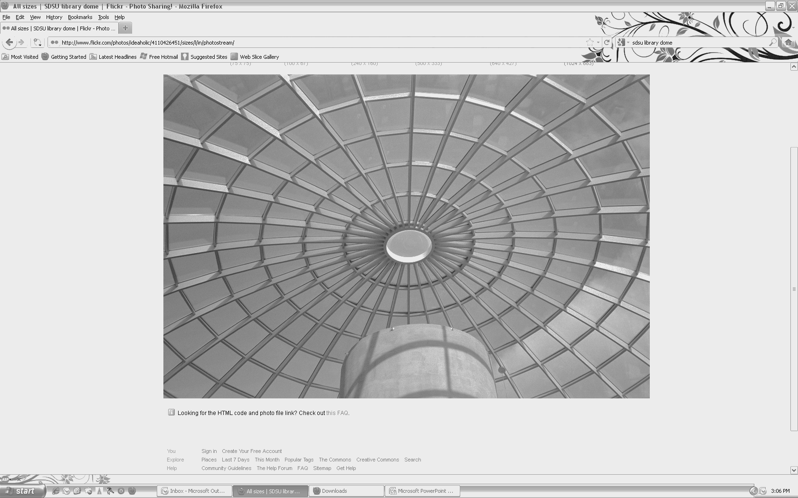
Department of Aerospace Engineering
SEMINAR
“Working Together for a Stronger Aerospace Engineering Department at SDSU”
Ping Lu, Ph.D.
Monday, March 23, 2015 – 10:30am
College of Engineering, Room E-203
In this presentation an overview of my research program will be given on what I do, and how the research fits in the big picture of the current aerospace technology landscape and needs, particularly in space technology. Several research projects ranging from advanced entry guidance to autonomous spacecraft rendezvous and proximity operations will be described in some detail, concluded with a plan for continuing and expanding research. Then some personal thoughts will be shared on aspirations, challenges, and strategies toward a stronger Aerospace Engineering Department at SDSU, from education, research, to institutional and community contributions.
Speaker Bio: Ping Lu received his Bachelor’s degree from then Beijing Institute of Aeronautics in 1982, and his Ph.D. degree in Aerospace Engineering from the University of Michigan in 1988. He has been on the faculty of Aerospace Engineering at Iowa State University since 1990, where he is presently a Professor. His research interests and expertise are in the area of Guidance, Control, and Flight Dynamics, specifically, advanced guidance of space transportation systems, computational control, and autonomous trajectory planning. He has been the principal investigator for 20 research projects sponsored by NASA, DoD, and the Aerospace Industry, including those from several major NASA programs on space transportation systems. Prof. Lu has also been a consultant for several aerospace companies. Prof. Lu was the recipient of the prestigious Mechanics and Control of Flight Award from the American Institute of Aeronautics and Astronautics (AIAA) in 2008, “for contributions in advanced guidance algorithms for entry and ascent flight”. Prof. Lu is the Editor-in-Chief of the AIAA Journal Guidance, Control, and Dynamics, the premier international journal in aerospace guidance, control, and flight dynamics.
.
San Diego State University
Department of Aerospace Engineering ▪ 5500 Campanile Drive ▪ San Diego ▪ CA ▪ 92182-1323
Phone: 619-594-6074
http://aerospace.sdsu.edu/aerospaceengineering/

