Slide 1

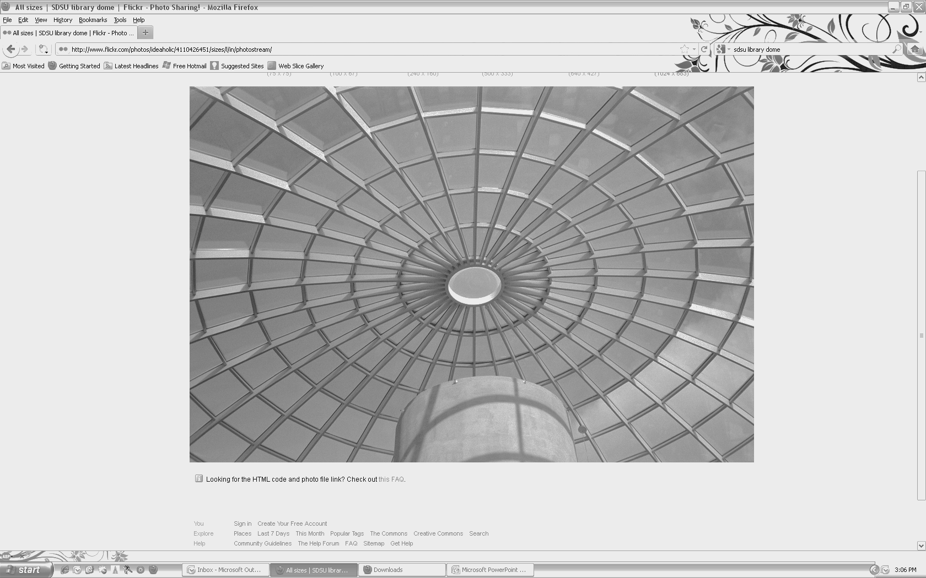
Department of Aerospace Engineering
SEMINAR
“Reshaping Engineering Education through Project Based Learning”
From Insects to MAV - the Next Grand Challenge in Aerodynamic Design
Dr. George Huang
Thursday, March 19, 2015 – 10:30am
College of Engineering, Room E-203
The MAV potentially has a variety of civilian as well as military uses too difficult or dangerous for humans, from searching buildings or caves for terrorists to probing damaged nuclear power plants for radiation leaks or collapsed mine shafts for survivors. Our understanding of the fundamental flight aerodynamics for MAV is limited. Traditional fixed wing flight concepts begin to fail as the flow dynamics enter a regime of bird-sized flights. The small scale of such vehicles poses a need for a dramatic change in the air vehicle design paradigm, one as great as that faced by the Wright Brothers in which they identified that control was the missing link in a workable aircraft. This new paradigm is simultaneous multi-disciplinary design of integrated multi-functional components and systems.
There are at least eight inter-connected scientific disciplines within the MAV design trade space: airframe & structures, aerodynamics, navigation, feedback & control, materials, sensors & actuators, propulsion & power, and communications. Our aim is to push the envelope of the current commercial off the shelf (COTS) technology in the early design cycle of MAV studies using the project based learning (PBL) approach. The topic is divided into many areas including insect flight dynamics exploration, bio-mimicking rapid prototyping, high definition precision manufacturing and machining, computer optimization and simulation, wind-house experimentation and flight testing. We will address not only the utilization of the high-precision machining tools in fabricating the MAV parts, such as Rapid Prototyping 3D printing and sintering, Electrical Discharge Machining, Laser Micromachining techniques, and micro CNC, but also the use of modern computational and experimental methods in optimizing the designs.
Speaker Bio: Dr. George Huang is the Professor and Chair in the Department of Mechanical and Materials Engineering at Wright State University (WSU). Dr. Huang completed his undergraduate degree in Taiwan (CYCU), MS in Canada (McGill University) and PhD from Manchester, England (UMIST). Dr. Huang taught at Michigan Technology University and University of Kentucky. He also worked at Stanford University and NASA-Ames on turbulence modeling and National Aero Space Plane (NASP), respectively. Dr. Huang has been involved in a wide range of research areas including CFD, turbulence/transition modeling, plasma-assisted flow control, advanced manufacturing, Micro Air Vehicles (MAV) and blood circulation in human. He received many awards including the NASA software of the year honorable mention award, Ackroyd Stuart prize and Silver Award of British Royal Aeronautical Society. The MAV designed by him and his students was cited as the drone of the future by the WIRED magazine. He is also a fellow of ASME, an associate Fellow of AIAA and a Professional Engineer in Mechanical Engineering.
San Diego State University
Department of Aerospace Engineering ▪ 5500 Campanile Drive ▪ San Diego ▪ CA ▪ 92182-1323
Phone: 619-594-6074
http://aerospace.sdsu.edu/aerospaceengineering/

